Slide 1

National University Of Sciences and Technology
Ansys Workbench
Zohaib Ali
ME-1915
Section A CMS 426042
Instructor Engineer Sir Affan

Slide 2
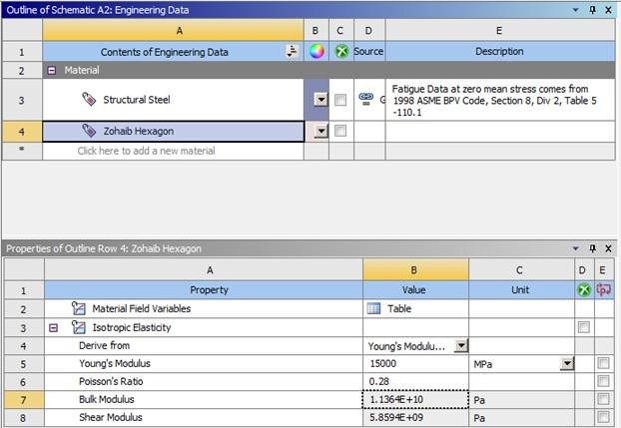
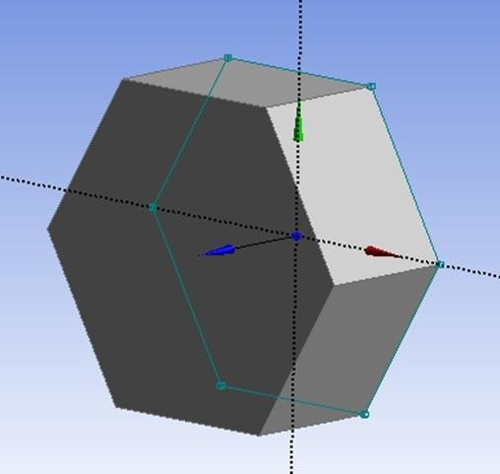
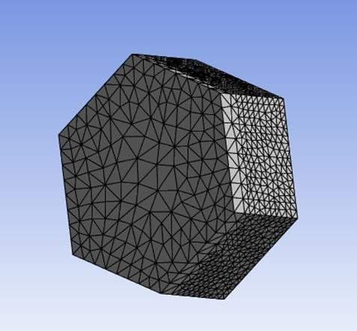
Static Structural
A new material named "Zohaib Hexagon"
Young's Modulus: 15000 MPa
Poisson's Ratio: 0.28
Extruded by 3 meters to
create a 3D hexagonal prism
An automatic mesh was applied to the 3D structure in
the Model analysis

Slide 3
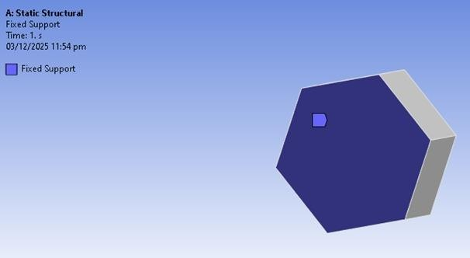
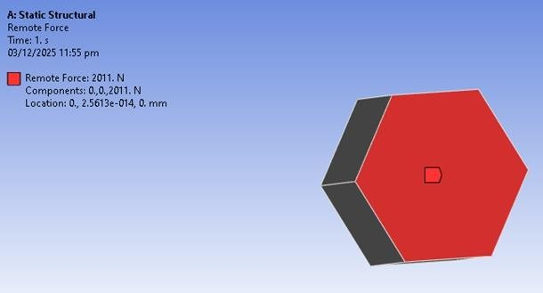
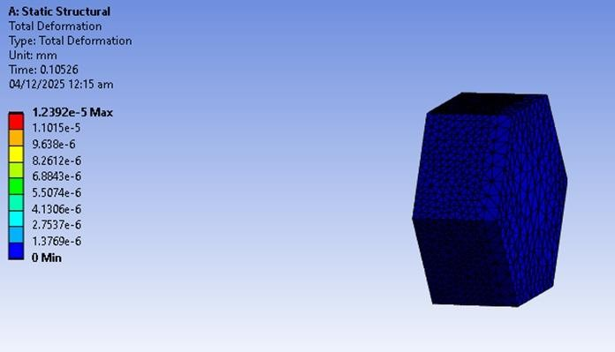
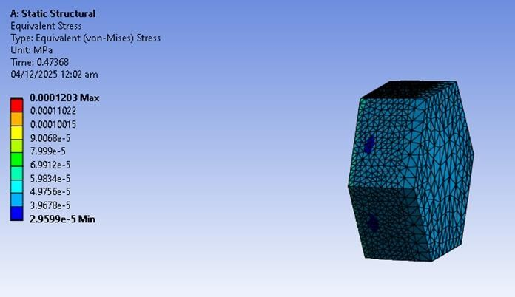
Boundary Conditions and Loading
Fixed Support: One face of the hexagonal geometry was constrained with a Fixed Support.
Remote Force Application: A Remote Force of 2011 N was applied to the other, opposite face.
The total displacement field was calculated and visualized.
Equivalent (von-Mises) Stress: The equivalent stress was calculated and visualized, with a maximum value of 0.0001203 MPa.

Slide 4
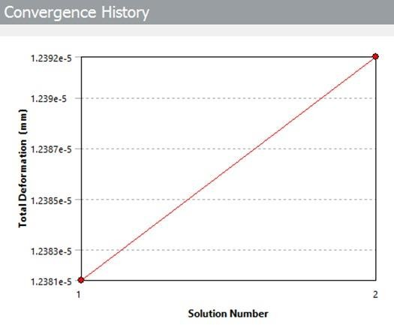
Mesh Convergence: A Convergence History Graph generated. This plot of Total Deformation (mm) versus Solution Number (e.g., mesh size refinement) demonstrates that the solution is approaching a stable value as the mesh is refined, indicating the results are reliable.

Slide 5
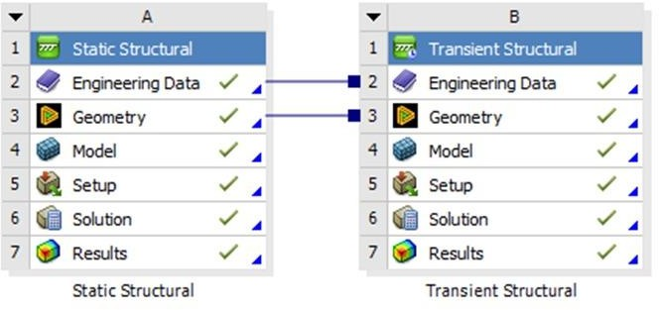
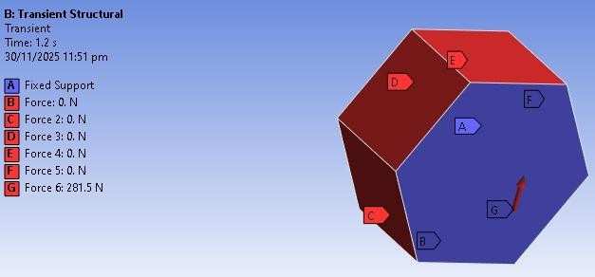
Transient Structural
The Engineering Data (material properties) and Geometry (the hexagonal shape) from the previous Static Structural analysis were connected and used for the time-dependent study.
A force of 281.5 N was applied. This force is applied across six faces of the hexagon. The simulation ran with a time interval of 0.2 seconds for a total time of 1.2 seconds.

Slide 6
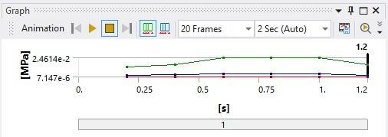
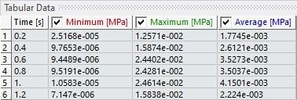
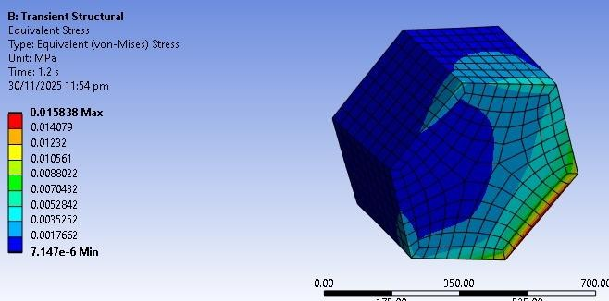
Generated graph after solving applied force in tabular form.
A graph showing the time- varying results and a Tabular Data table of minimum, maximum, and average stress values is generated.
The maximum Equivalent (von-Mises) Stress at the final time (t=1.2s) was 0.015838 MPa.

Slide 7
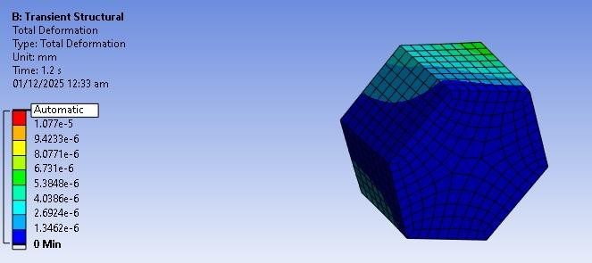
The maximum Total Deformation

